Slide 1
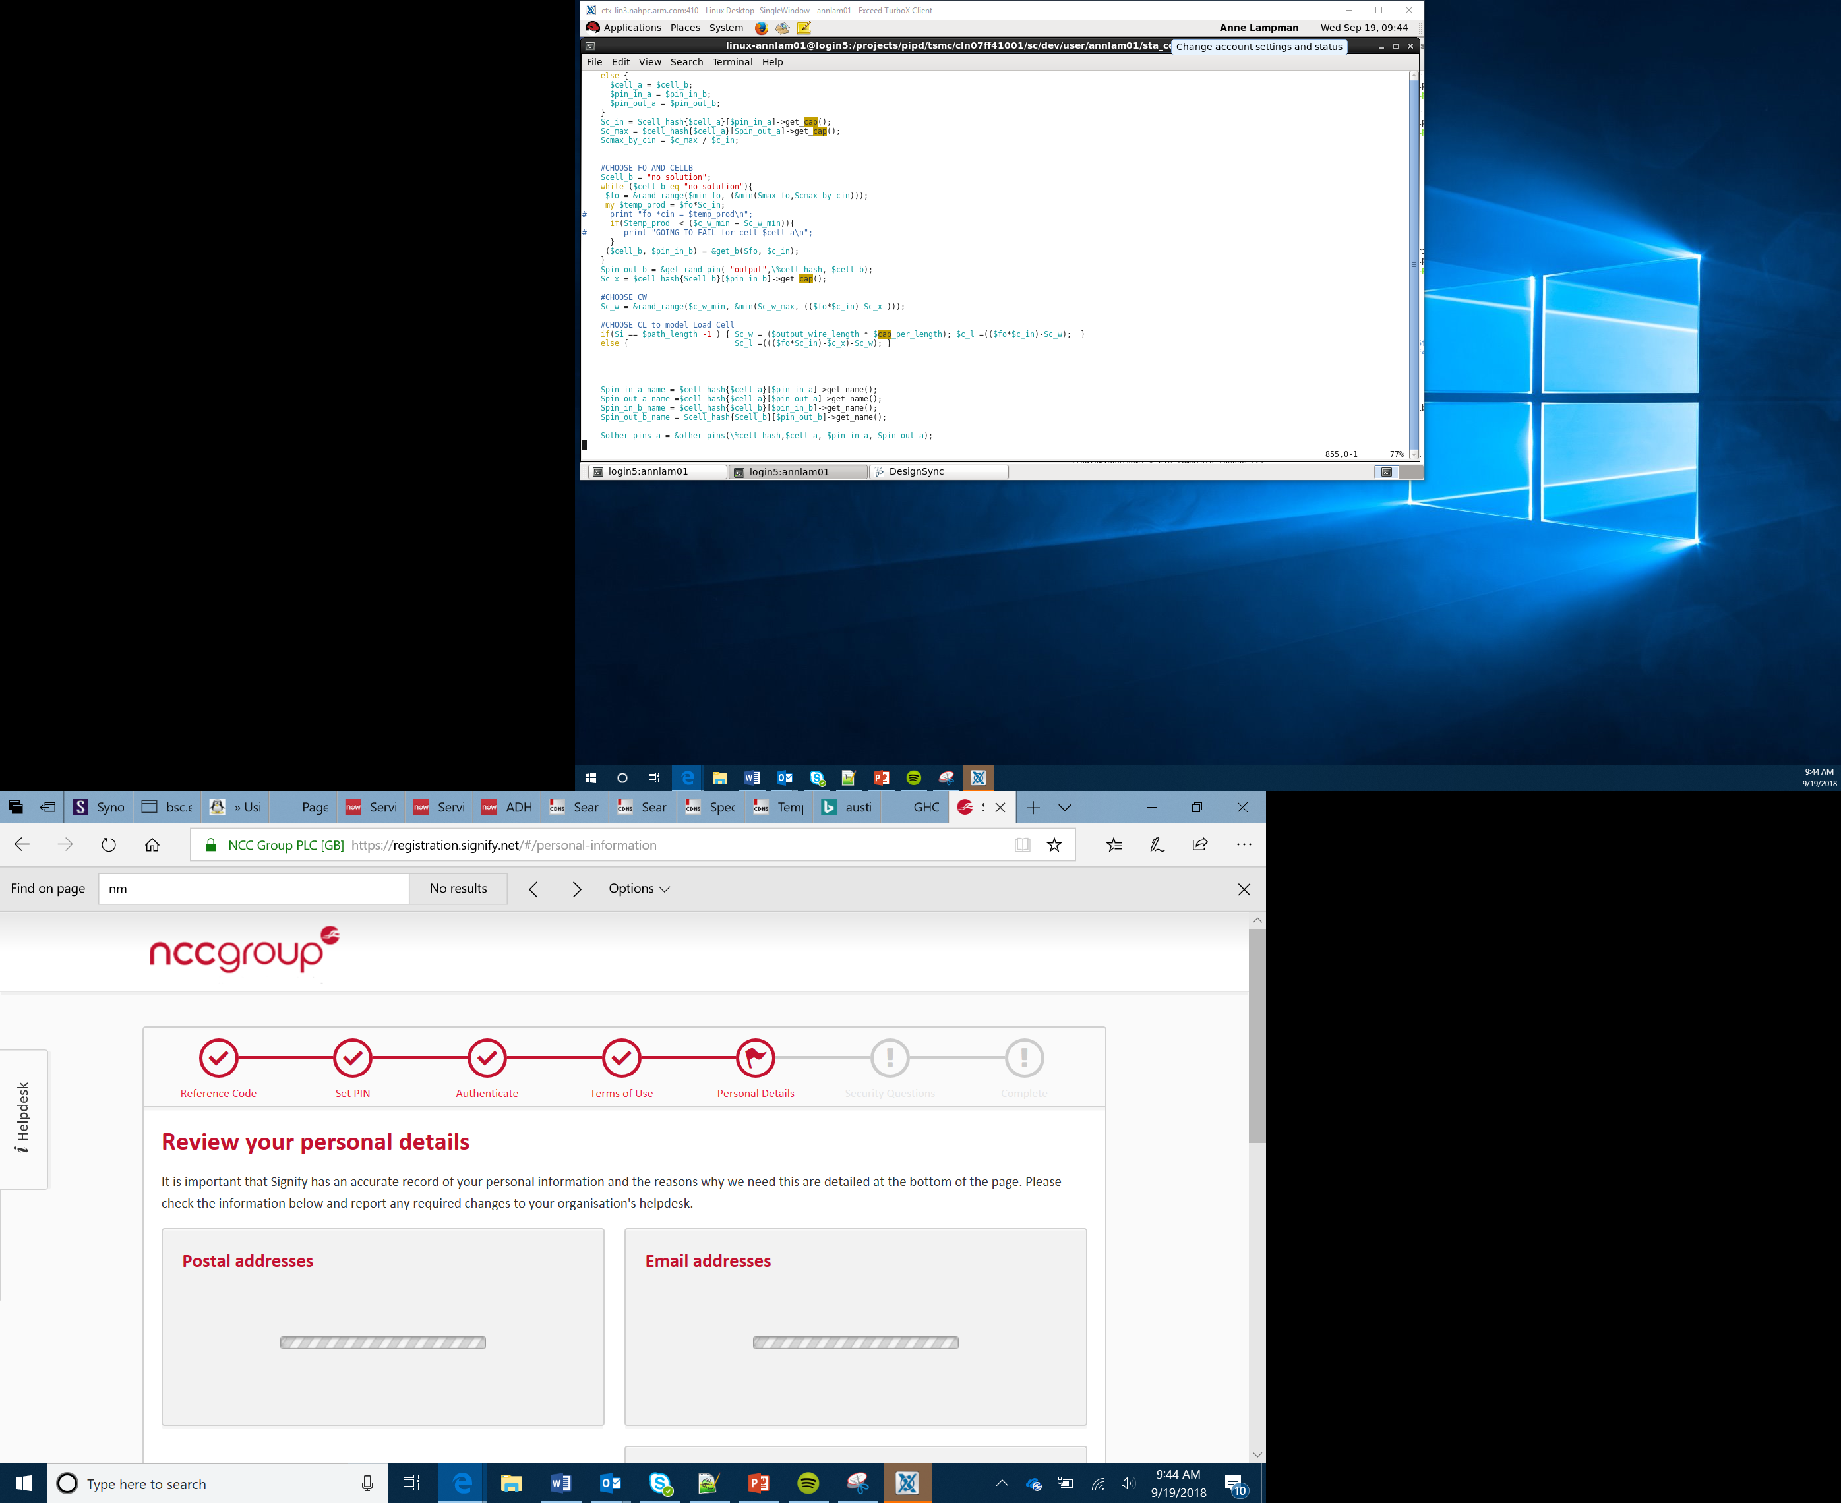

Data analysis, machine learning and artificial intelligence
Lesson 5
Notes:
Introduce students to the overall purpose of the lesson. Today they will explore what machine learning and artificial intelligence are. They will be introduced to the Python programming language and will build their first Python program.

Slide 2
Success criteria
Understand how to install libraries within Python
Understand how to use various data analysis libraries within Python
Understand how to train a model
Understand how to use a trained model to make predictions

Slide 3
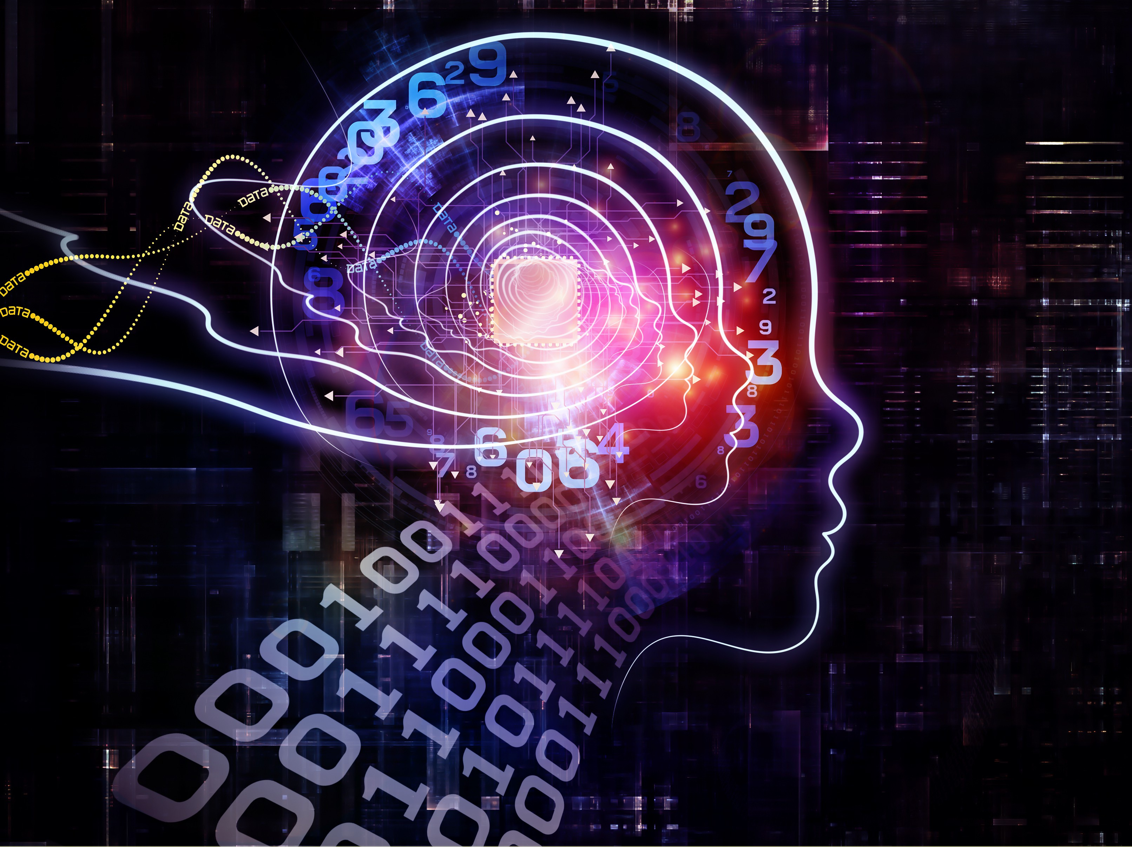
Intelligence
What is intelligence?
In pairs, discuss whether computers can truly have intelligence
This Photo by Unknown Author is licensed under CC BY-NC
Notes:
Introduce the concept of intelligence. Ask students if they can describe what intelligence is. Oxford languages define intelligence as “the ability to acquire and apply knowledge and skills”. Students should then discuss in pairs whether computers can have true intelligence. There are likely to be a number of different views over whether computers can truly have intelligence. Some may argue that a programmer can write a program to allow a computer to acquire knowledge through a range of inputs so this meets the definition of intelligence. Others may argue that intelligence requires consciousness.

Slide 4
The Chinese Room problem
Research the Chinese Room problem
You could use https://plato.stanford.edu/entries/chinese-room/
Summarise your findings on the ‘Chinese Room problem’ worksheet
Following your analysis, have you changed you mind over whether machines can be intelligent?
Notes:
The experiment was carried out by John Searle. One person is inside a room with a number of filing cabinets, each of which matches a question in mandarin to an answer. The person in the room does not speak Mandarin. A Mandarin speaker then passes a message to the person in the room. They then look through the filing cabinet to find the question with an associated response. They select the appropriate answer and pass it back to the Mandarin speaker outside the room. They then read the response. The person in the room was able to select an appropriate responses without understanding the question that was asked or the response provided. Searle therefore argued that intelligence wasn’t used.

Slide 5
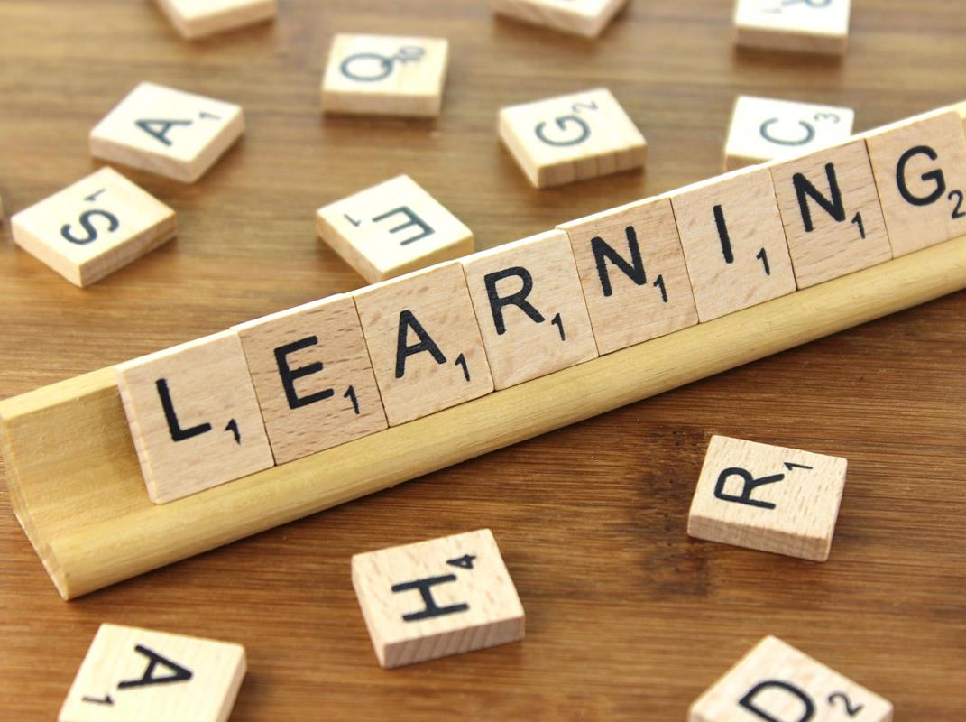
Types of learning
Supervised learning involves using labelled data to build a model
Unsupervised learning uses unlabelled data, which the system uses to determine relationships between different pieces of data
This Photo by Unknown Author is licensed under CC BY-SA
Notes:
Highlight the difference between supervised and unsupervised learning. The model which students are going to build uses supervised learning. They will be taking a data set which contains data which is labelled. They will then use a range of training data to build the model and test it with the remaining data to see how accurately the model can determine the classification.

Slide 6
Using a Python IDE
Python is a high-level language, similar to the language which the Arduino uses although the syntax is different
You are going to use a number of different libraries to create and train an AI model
There are a number of different IDEs which contain the similar development tools to the Arduino IoT cloud
One online IDE is https://repl.it
Notes:
Inform students that they will be building their model using Python which offers a wide range of existing libraries to allow them to create an AI model. It is important that students understand that the syntax is different to the Arduino. There are a number of different IDEs which can be used from installed versions such as IDLE and PyCharm through the online versions such as repl. Repl has been recommended as this will allow students to easily import the libraries that are required.

Slide 7
Your AI model
You are going to use a set of data which determines the classification of an iris
You will import the csv file
You will explore the data
You will analyse the data
You will then use an existing program to create a link between a range of characteristics of the Iris and its classification
You will then use the model to make a number of predictions
Work though Lesson 5 – ‘Building an AI model’ worksheet
Notes:
The base data is provided in the Iris dataset csv. The instructions work through this dataset. More capable learners may wish to explore alternate data sets. A wide range of different data sets are available online from https://data-flair.training/blogs/machine-learning-datasets/.

Slide 8
Summary
Intelligence is the ability to acquire and apply knowledge and skills
Supervised learning uses labeled data to train a model
Many argue against machines having true intelligence

